Slide 1
MGS 425 Management of it projects
Week 1 – February 1st

Slide 2
Agenda
Instructor Introduction
Review Syllabus
Chapter 1 – Essential Scrum Introduction

Slide 3
Essential Scrum Introduction
What is Scrum?
Scrum is an agile approach for developing innovative products and services. Figure 1.1 shows a simple, generic, agile development approach.
Notes:
agile. 1. A specific set of values and principles, as expressed in the Agile Manifesto (Beck et al. 2001). 2. An umbrella term used for a group of related approaches to software development based on iterative and incremental development. Scrum is an agile approach to development. See also Extreme Programming, Kanban, Scrum.
Extreme Programming (XP). An agile development approach that is complementary to Scrum. Extreme Programming specifies important technical practices that development teams use to manage the flow of task-level work during sprint execution. See also agile.
Kanban. An agile approach overlaid on an existing process that advocates visualizing how work flows through a system, limiting the work in process, and measuring and optimizing the flow of work.

Slide 4
Essential Scrum Introduction
Agile Development Overview
Product Backlog
Features
Iterations
Cross-Functional Teams
Adaptive Process Oriented
Notes:
With an agile approach, you begin by creating a product backlog—a prioritized list of the features and other capabilities needed to develop a successful product. Guided by the product backlog, you always work on the most important or highest-priority items first. When you run out of resources (such as time), any work that didn’t get completed will be of lower priority than the completed work.
feature. 1. A slice of business functionality that is meaningful to a customer or user. 2. Used by some to mean a medium-size user story that can and will be divided into a collection of smaller user stories that together will be implemented to deliver the value of a feature.
The work itself is performed in short, timeboxed iterations, which usually range from a week to a calendar month in length. During each iteration, a self-organizing, cross-functional team does all of the work—such as designing, building, and testing—required to produce completed, working features that could be put into production.
Typically the amount of work in the product backlog is much greater than can be completed by a team in one short-duration iteration. So, at the start of each iteration, the team plans which high priority subset of the product backlog to create in the upcoming iteration. In Figure 1.1, for example, the team has agreed that it can create features A, B, and C.
At the end of the iteration, the team reviews the completed features with the stakeholders to get their feedback. Based on the feedback, the product owner and team can alter both what they plan to
work on next and how the team plans to do the work. For example, if the stakeholders see a completed feature and then realize that another feature that they never considered must also be included in the product, the product owner can simply create a new item representing that feature and insert it into the product backlog in the correct order to be worked on in a future iteration.
At the end of each iteration, the team should have a potentially shippable product (or increment of the product), one that can be released if appropriate. If releasing after each iteration isn’t appropriate, a set of features from multiple iterations can be released together.
As each iteration ends, the whole process is begun anew with the planning of the next iteration.

Slide 5
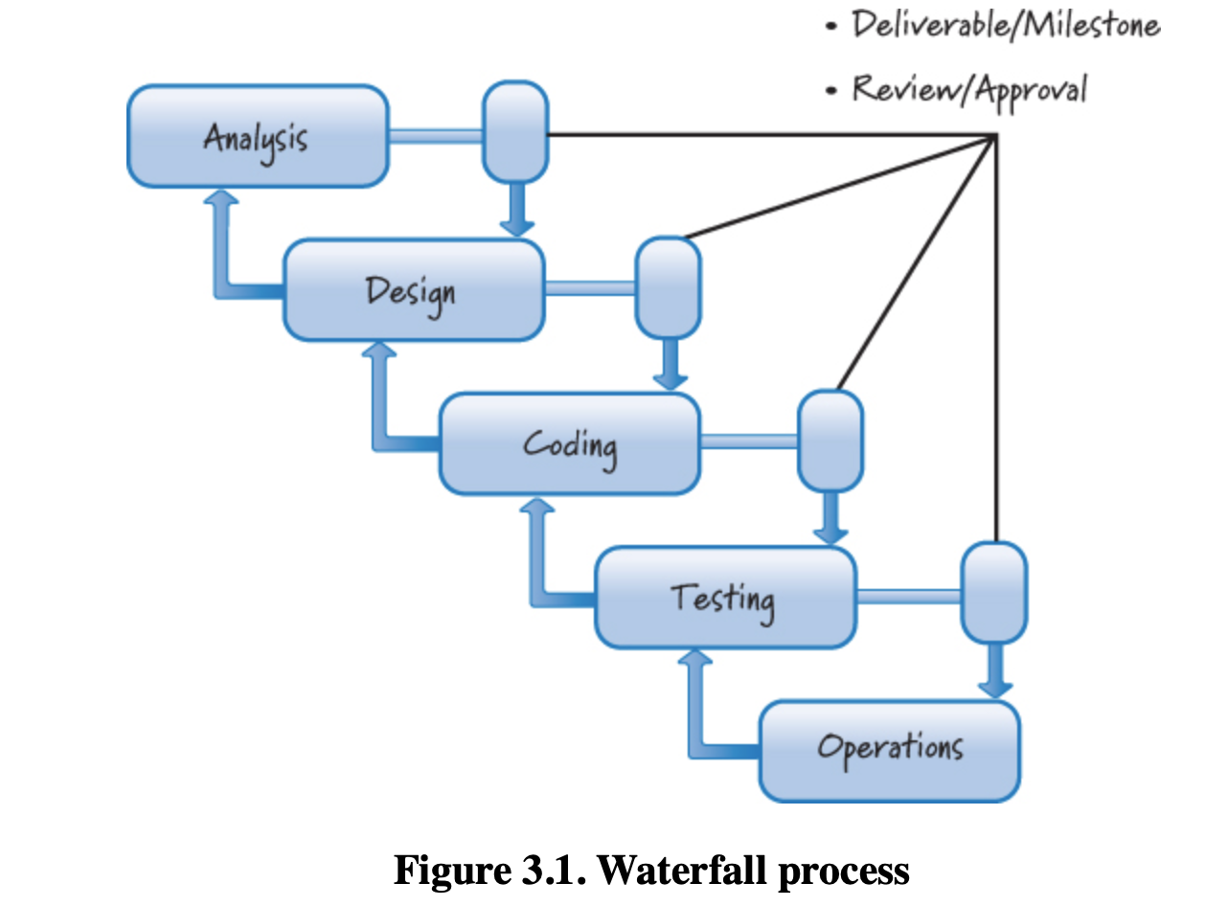
Essential Scrum Introduction
Waterfall Development Overview
A term referring to the graphical depiction of a development process in which the sequential phases of work are shown flowing steadily downwards like a cascading waterfall.
Attempt to plan for and anticipate up front all of the features a user might want in the end product and to determine how best to build those features.
The work plan is based on execution of a sequential set of work-specific phases.
Plan Driven Process Oriented.

Slide 6
Essential Scrum Introduction
Origin of Scrum
Scrum’s rich history can be traced back to a 1986 Harvard Business Review article, “The New New Product Development Game” (Takeuchi and Nonaka 1986).
This article describes how companies such as Honda, Canon, and Fuji-Xerox produced world-class results using a scalable, team-based approach to all-at-once product development.
It also emphasizes the importance of empowered, self-organizing teams and outlines management’s role in the development process.
Scrum is not an acronym, but rather a term borrowed from the sport of rugby, where it refers to a way of restarting a game after an accidental infringement or when the ball has gone out of play.
Notes:
all-at-once product development. Doing all types of work (for example, analysis, design, coding, integrating, and testing) opportunistically within a single iteration.

Slide 7
Essential Scrum Introduction
Origin of Scrum
Though Scrum is most commonly used to develop software products, the core values and principles of Scrum can and are being used to develop different types of products or to organize the flow of various types of work.
Scrum has also been used for organizing and managing the work associated with hardware development, marketing programs, and sales initiatives.

Slide 8
Essential Scrum Introduction
Why Scrum?
Allows for quick exploration of new ideas and approaches and able to learn fast which solutions are viable and which are not.
Avoids the need for detailed, up-front planning and architecture design.
Supports cross-functional teams and for all team members to synchronize frequently (e.g. daily).
Notes:
We had a strategic corporate partner to whom we needed to show working results every few weeks or so to get feedback, because our product had to integrate with its core line of DNA sequencers.
A previous attempt to create a next generation of Genomica’s core product had seen the organization spend almost one year doing architecture-only work to create a grand, unified bioinformatics platform. When the first real scientist-facing application was put on top of that architecture, and we finally validated design decisions made many months earlier, it took 42 seconds to tab from one field on the screen to the next field. If you think a typical user is impatient, imagine a molecular biologist with a Ph.D. having to wait 42 seconds! It was a disaster. We needed a different, more balanced approach to design, which included some design up front combined with a healthy dose of emergent, just-in-time design.

Slide 9
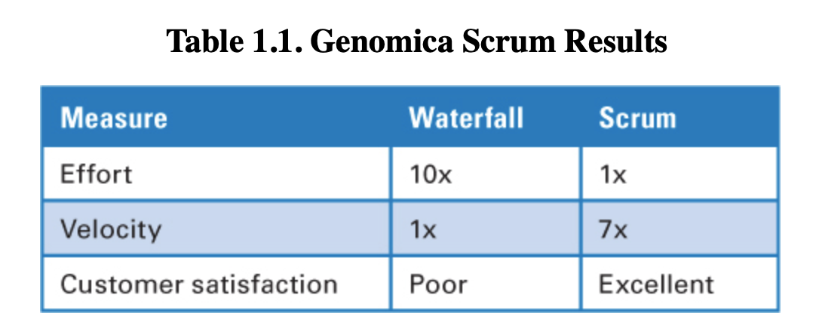
Essential Scrum Introduction
Example of Results in Action
Notes:
From an effort perspective, with Scrum development we required one-tenth the amount of effort (calculated in person-months) compared to our previous use of a plan-driven, waterfall-style approach to develop a comparable amount of product functionality. Equally important, the Scrum development progressed at seven times the velocity of the waterfall development, meaning that per unit of time, the Scrum development produced about seven times more valuable features than the waterfall development. Even more compelling was that we delivered the software to our partner in a time frame that met the expectations for the launch of its new hardware platform.

Slide 10
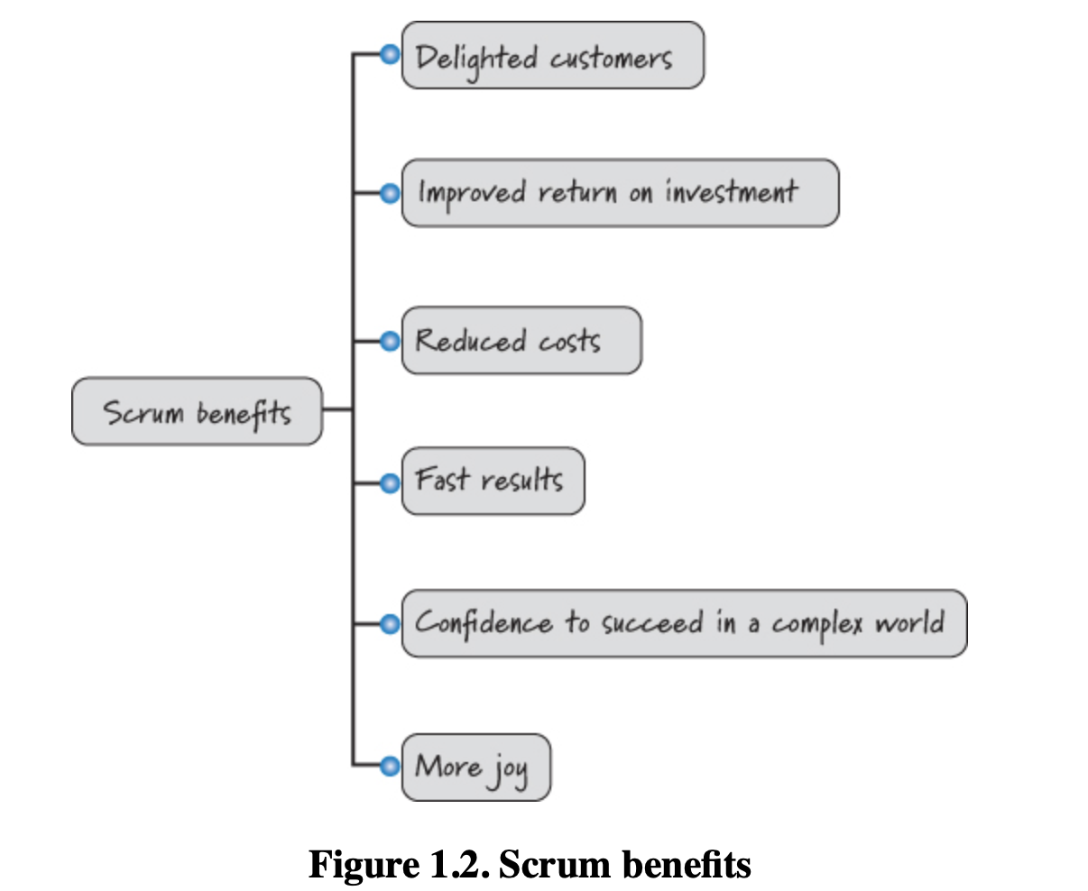
Essential Scrum Introduction
Benefits of using Scrum
Notes:
These organizations are repeatedly delighting their customers by giving them what they really want, not just the features they might have specified on the first day when they knew the least about their true needs. They are also seeing an improved return on investment by delivering smaller, more frequent releases.
Scrum’s focus on delivering working, integrated, tested, business-valuable features each iteration leads to results being delivered fast. Scrum is also well suited to help organizations succeed in a complex world where they must quickly adapt based on the interconnected actions of competitors, customers, users, regulatory bodies, and other stakeholders. And Scrum provides more joy for all participants. Not only are customers delighted, but also the people doing the work actually enjoy it! They enjoy frequent and meaningful collaboration, leading to improved interpersonal relationships and greater mutual trust among team members.

Slide 11
Essential Scrum Introduction
To Scrum or not to Scrum?
Notes:
Though Scrum is an excellent solution for many situations, it is not the proper solution in all circumstances. The Cynefin framework (Snowden and Boone 2007) is a sense-making framework that helps us understand the situation in which we have to operate and decide on a situation-appropriate approach.
It defines and compares the characteristics of five different domains: simple, complicated, chaotic, complex, and a fifth domain, disorder, which occurs when you don’t know which other domain you are in (see Figure 1.3).
I will use the Cynefin framework to discuss situations in which Scrum is and is not a good fit.
The Cynefin framework helps leaders determine the prevailing operative context so that they can make appropriate choices. Each domain requires different actions. Simple and complicated contexts assume an ordered universe, where cause-and-effect relationships are perceptible, and the correct answers can be determined based on the facts. Complex and chaotic contexts are unordered—there is no immediately apparent relationship between cause and effect, and the way forward is determined based on emerging patterns. The ordered world is the world of fact-based management; the unordered world represents pattern-based management.
The very nature of the fifth context—disorder—makes it particularly difficult to recognize when one is in it. Here, multiple perspectives jostle for prominence, factional leaders argue with one another, and cacophony rules. The way out of this realm is to break down the situation into constituent parts and assign each to one of the other four realms. Leaders can then make decisions and intervene in contextually appropriate ways.

Slide 12
Essential Scrum Introduction
Cynefin Framework
Pronounced: (kuh-NEV-in)
Software development and support will not fit neatly into just one Cynefin domain or context.
Software development is a rich endeavor, with aspects that overlap and activities that fall into all of the different domains.
So, while most software development work falls in the domains of complicated or complex, to claim that software development is only a complex domain would be naïve.
Considering that software development includes the spectrum of work ranging from innovative new-product development, ongoing software product maintenance, and operations and support, further supports this theory.
Notes:
The Cynefin framework helps leaders determine the prevailing operative context so that they can make appropriate choices. Each domain requires different actions. Simple and complicated contexts assume an ordered universe, where cause-and-effect relationships are perceptible, and right answers can be determined based on the facts. Complex and chaotic contexts are unordered—there is no immediately apparent relationship between cause and effect, and the way forward is determined based on emerging patterns. The ordered world is the world of fact-based management; the unordered world represents pattern-based management.
The very nature of the fifth context—disorder—makes it particularly difficult to recognize when one is in it. Here, multiple perspectives jostle for prominence, factional leaders argue with one another, and cacophony rules. The way out of this realm is to break down the situation into constituent parts and assign each to one of the other four realms. Leaders can then make decisions and intervene in contextually appropriate ways.

Slide 13
Essential Scrum Introduction
Cynefin Framework – Complex Domain/Context
When dealing with complex problems, there are more unknowns than there are knowns. If there is a right answer, it only be known in hindsight.
This is referred to as the domain of “Emergence”.
We need to explore to learn about the problem, then inspect and adapt based on our learning.
Working in complex domains requires creative and innovative approaches. Routine, cookie-cutter solutions simply don’t apply.
A safe-fail environment for experimentation is crucial so that we can discover important information. In this environment high levels of interaction and communication are essential. Innovative new-product development falls into this category as does enhancing existing products with innovative new features.
Scrum is particularly well suited for operating in a complex domain. In such situations our ability to probe (explore), sense (inspect), and respond (adapt) is critical.
Notes:
In a complicated context, at least one right answer exists. In a complex context, however, right answers can’t be ferreted out. It’s like the difference between, say, a Ferrari and the Brazilian rainforest. Ferraris are complicated machines, but an expert mechanic can take one apart and reassemble it without changing a thing. The car is static, and the whole is the sum of its parts. The rainforest, on the other hand, is in constant flux—a species becomes extinct, weather patterns change, an agricultural project reroutes a water source—and the whole is far more than the sum of its parts. This is the realm of “unknown unknowns,” and it is the domain to which much of contemporary business has shifted.
Most situations and decisions in organizations are complex because some major change—a bad quarter, a shift in management, a merger or acquisition—introduces unpredictability and flux. In this domain, we can understand why things happen only in retrospect. Instructive patterns, however, can emerge if the leader conducts experiments that are safe to fail. That is why, instead of attempting to impose a course of action, leaders must patiently allow the path forward to reveal itself. They need to probe first, then sense, and then respond.

Slide 14
Essential Scrum Introduction
Cynefin Framework – Complicated Domain/Context
Complicated problems are the domain of good practices dominated by experts. There might be multiple right answers, but expert diagnosis is required to figure them out.
Although Scrum can certainly work with these problems, it might not be the best solution.
Much of day-to-day software maintenance (dealing with a flow of product support or defect issues) falls into this category.
This is also where many of the tactical, quantitative approaches like Six Sigma are particularly well suited, although these tactical approaches can also apply with simple domains.
Notes:
For example, a performance optimization effort that calls for adjusting parameters to find the best overall system performance would be better served by assembling experts and letting them assess the situation, investigate several options, and base their response on good practice.
Complicated contexts, unlike simple ones, may contain multiple right answers, and though there is a clear relationship between cause and effect, not everyone can see it. This is the realm of “known unknowns.” While leaders in a simple context must sense, categorize, and respond to a situation, those in a complicated context must sense, analyze, and respond. This approach is not easy and often requires expertise: A motorist may know that something is wrong with his car because the engine is knocking, but he has to take it to a mechanic to diagnose the problem.
Because the complicated context calls for investigating several options—many of which may be excellent—good practice, as opposed to best practice, is more appropriate. For example, the customary approach to engineering a new cell phone might emphasize feature A over feature B, but an alternative plan—emphasizing feature C—might be equally valuable.
Another example is the search for oil or mineral deposits. The effort usually requires a team of experts, more than one place will potentially produce results, and the location of the right spots for drilling or mining involves complicated analysis and understanding of consequences at multiple levels.

Slide 15
Essential Scrum Introduction
Cynefin Framework – Simple Domain/Context
When dealing with simple problems, cause and effect is often clear and the right answer is obvious and undisputed.
This is the domain of legitimate best practices.
There are known solutions. Once we assess the facts of our situation, we can determine the proper predefined solution to use.
Scrum can be used for simple problems, but it may not be the most efficient tool for this type of problem.
Using a process with a well-defined, repeatable set of steps that are known to solve the problem would be a better fit.
Notes:
For example, if we want to reproduce the same product over and over again, a well-defined assembly-line process would be a better fit than Scrum. Or deploying the same commercial-off-the-shelf (COTS) product into the 100th customer environment might best be completed by repeating a well-defined and proven set of steps for installing and configuring the product.
Simple contexts are characterized by stability and clear cause-and-effect relationships that are easily discernible by everyone. Often, the right answer is self-evident and undisputed. In this realm of “known knowns,” decisions are unquestioned because all parties share an understanding. Areas that are little subject to change, such as problems with order processing and fulfillment, usually belong here.
Simple contexts, properly assessed, require straightforward management and monitoring. Here, leaders sense, categorize, and respond. That is, they assess the facts of the situation, categorize them, and then base their response on established practice. Heavily process-oriented situations, such as loan payment processing, are often simple contexts. If something goes awry, an employee can usually identify the problem (when, say, a borrower pays less than is required), categorize it (review the loan documents to see how partial payments must be processed), and respond appropriately (either not accept the payment or apply the funds according to the terms of the note). Since both managers and employees have access to the information necessary for dealing with the situation in this domain, a command-and-control style for setting parameters works best. Directives are straightforward, decisions can be easily delegated, and functions are automated. Adhering to best practices or process reengineering makes sense. Exhaustive communication among managers and employees is not usually required because disagreement about what needs to be done is rare.

Slide 16
Essential Scrum Introduction
Cynefin Framework – Chaotic Domain/Context
Chaotic problems require a rapid response.
A crisis is unfolding and the organization needs to act immediately to prevent further harm and reestablish at least some order.
Scrum is not the best solution here.
Prioritizing a backlog of work and determining what work to perform in the next iteration is not the best course of action.
The organization needs to act immediately and decisively to control the damage.
With chaotic problems, someone needs to take charge of the situation and act.
Notes:
For example, suppose a university published an article stating that our product has a flawed algorithm that is producing erroneous results. Our customers have made substantial business investments based on the results from our product, and they are filing lawsuits against us for large damages. Our lead algorithm designer is on holiday in the jungles of Borneo and can’t be reached for two more weeks.
In a chaotic context, searching for right answers would be pointless: The relationships between cause and effect are impossible to determine because they shift constantly and no manageable patterns exist—only turbulence. This is the realm of unknowables. The events of September 11, 2001, fall into this category.
In the chaotic domain, a leader’s immediate job is not to discover patterns but to stanch the bleeding. A leader must first act to establish order, then sense where stability is present and from where it is absent, and then respond by working to transform the situation from chaos to complexity, where the identification of emerging patterns can both help prevent future crises and discern new opportunities. Communication of the most direct top-down or broadcast kind is imperative; there’s simply no time to ask for input.

Slide 17
Essential Scrum Introduction
Cynefin Framework – Disorder Domain/Context
The disorder domain comes into play when you don’t know which of the other domains you are in.
This is a dangerous place to be because you don’t know how to make sense of your situation.
In such cases, people tend to interpret and act according to their personal preference for action.
When you are in the disorder domain, the way out is to break down the situation into constituent parts and assign each to one of the other four domains.
You are not trying to apply Scrum in the disorder domain; you are trying to get out of this domain.
Notes:
The very nature of the fifth context—disorder—makes it particularly difficult to recognize when one is in it. Here, multiple perspectives jostle for prominence, factional leaders argue with one another, and cacophony rules. The way out of this realm is to break down the situation into constituent parts and assign each to one of the other four realms. Leaders can then make decisions and intervene in contextually appropriate ways.

Slide 18
Essential Scrum Introduction
Interrupt-Driven Work – Not a Good Fit for Scrum
Scrum is not well suited to highly interrupt-driven work.
For example, say an application support group wants to use Scrum to organize and manage support activities.
The product backlog is populated on a continuous basis through multiple channels (email, phone, etc.). At no point in time is there a product backlog that extends very far into the future, and the content and order of the backlog could change frequently (e.g. hourly or every few minutes).
In this situation, it will not be possible to reliably plan iterations of a week or more because you won’t know what the work will be that far into the future.
Often times, a high-priority support request will arrive and preempt any such forward-looking plans.
Notes:
In interrupt-driven environments you would be better off considering an alternative agile approach called Kanban. Kanban is not a stand-alone process solution, but instead an approach that is overlaid on an existing process. In particular, Kanban advocates that you
• Visualize how the work flows through the system (for example, the steps that the support organization takes to resolve a support request)
• Limit the work in process (WIP) at each step to ensure that you are not doing more work than you have the capacity to do
• Measure and optimize the flow of the work through the system to make continuous improvements
The sweet spots for Kanban are the software maintenance and support areas. Some Kanban practitioners point out that Kanban’s focus on eliminating overburden (by aligning WIP with capacity) and reducing variability in flow while encouraging an evolutionary approach to change makes it appropriate to use in complex domains as well.
Scrum and Kanban are both agile approaches to development, and each has strengths and weaknesses that should be considered once you make sense of the domain in which you are operating. In some organizations both Scrum and Kanban can be used to address the different system needs that coexist. For example, Scrum can be used for new-product development and Kanban for interrupt-driven support and maintenance.

Slide 19
Essential Scrum Introduction
Closing
Scrum is not a silver bullet or a magic cure.
Scrum can, however, enable an organization to embrace the changes that accompany all complex product development efforts.
Although the Scrum framework is simple in theory, it would be a mistake to assume that Scrum is easy and painless to apply.
Scrum doesn’t prescriptively answer your process questions; instead, it empowers teams to ask and answer their own great questions.
Scrum doesn’t give individuals a cookbook solution to all of their organizational maladies; instead, Scrum makes visible the dysfunctions and waste that prevent organizations from reaching their true potential.
Notes:
These realizations can be painful for many organizations. However, if they move past the initial discomfort and work to solve the problems Scrum unearths, organizations can take great strides in terms of both their software development process and products and their levels of employee and customer satisfaction.

